Slide 1
INTRODUCTION TO 'NEXT GENERATION SEQUENCING'
Esther Camacho¹, Mireia Ferrer¹, Álex Sánchez^{1,2}, Angel Blanco^{1,2}, Berta Miró¹ ¹ Unitat d’Estadística i Bioinformàtica (UEB) VHIR ² Departament de Genètica Microbiologia i Estadística, UB

Slide 2
Introduction to NGS
First Generation Sequencing
Second Generation Sequencing
Third Generation Sequencing
Sequencing generation face to face
Applications of NGS techniques
A (very) brief introduction to DoE

Slide 3
Introduction to NGS
First Generation Sequencing
Second Generation Sequencing
Third Generation Sequencing
Sequencing generation face to face
Applications of NGS techniques
A (very) brief introduction to DoE

Slide 4
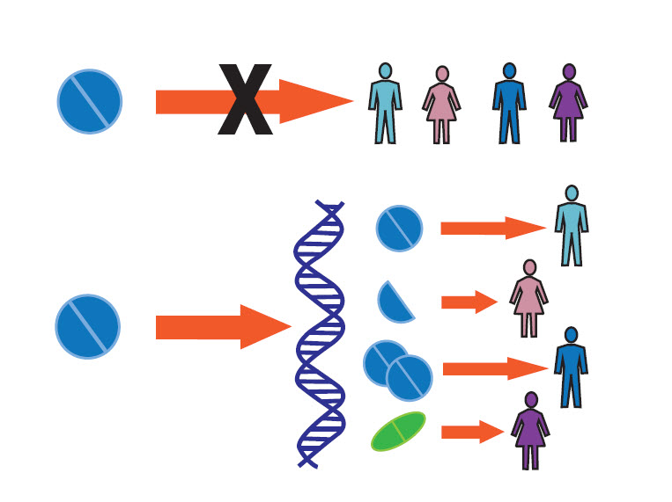

Introduction to NGS
Personalized medicine era
The right therapeutic strategy for the right person at the right time
https://www.pharmgkb.org/
Biomarker identification:
Diagnostic
Susceptibility/risk (prevention)
Prognostic
Predictive (response)
https://iipm.medicinedept.iu.edu/
Notes:
Qué necesidad hay de analitzar datos de NGS en el campo de la medicina personalizada

Slide 5
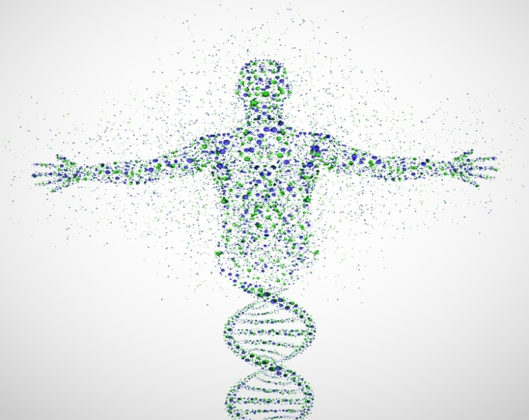
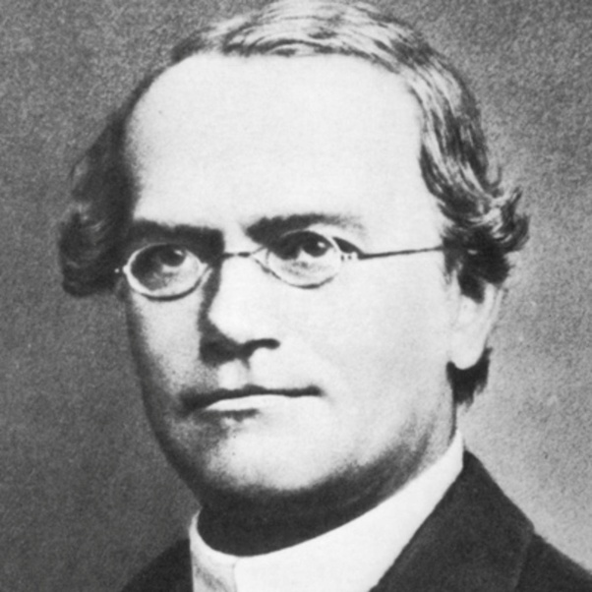
Introduction to NGS
Genomics is a branch of genetics that enables the study of genomes of whole organisms.
It differs from “classical genetics” in that it considers the hereditary material of an organism in global rather than one gene or one gene product at a time.
Gregor Mendel

Slide 6
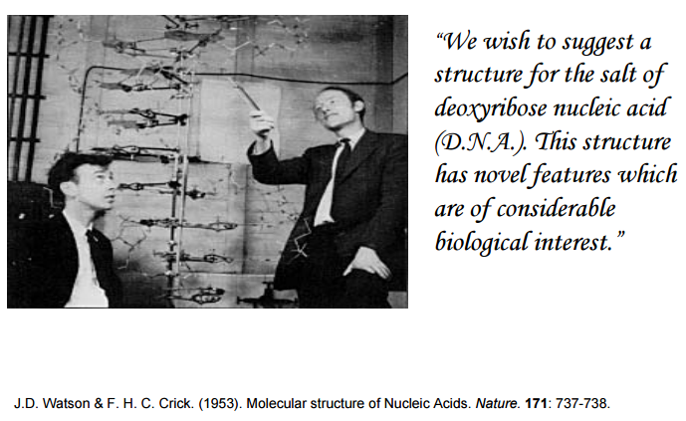
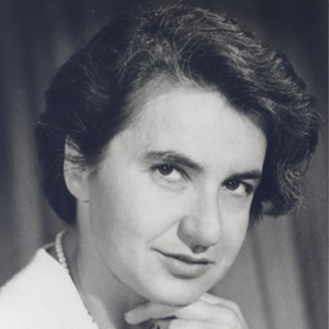
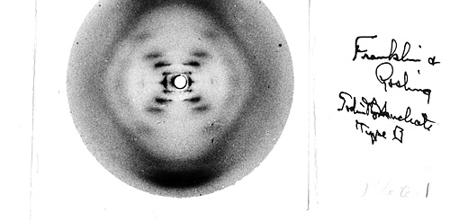
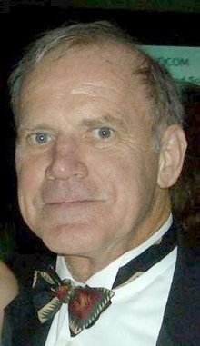
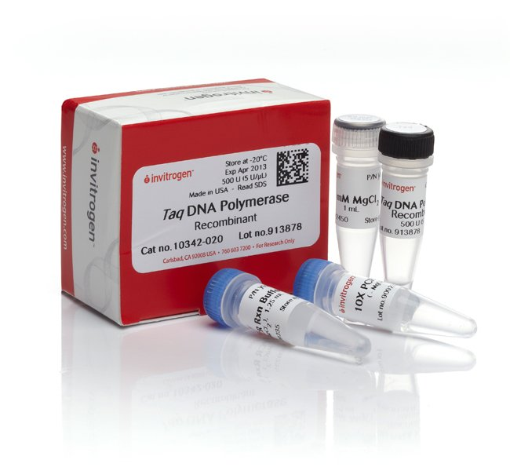
Introduction to NGS
Deoxyribose nucleic acid (DNA)
Polymerase Chain Reaction (PCR)
Notes:
Qué precedentes a la secuenciación masiva hubo
En 1953 James Watson y Francis Crick descubrieron la doble hélice gracias a la puesta en común de varios descubrimientos entre los que destacan las imágenes de rayos X de alta resolución de las fibras de ADN.
James Watson recibió el prestigioso galardón junto a sus colegas Maurice Wilkins y Francis Crick en 1962
In 1983, Kary Mullis, PhD, a scientist at the Cetus Corporation, conceived of PCR as a method to copy DNA and synthesize large amounts of a specific target DNA
PCR was awarded the 1993 Nobel Prize in Chemistry.

Slide 7

Introduction to NGS
Human Genome Project
The Human Genome Project (HGP) goal was the complete mapping and understanding of all the genes of human beings.
Begin in 1990
First draft in February 2001
full sequence April 2003
It catalyzes the developing and improving of sequencing techniques
Notes:
El Proyecto Genoma Humano (PGH) fue un proyecto internacional con el objetivo fundamental de determinar la secuencia del ADN del genoma humano.
En el año 2003, se completó la secuencia del genoma humano. El proyecto, dotado con 3000 millones de dólares, fue fundado en 1990 bajo la dirección del doctor Francis Collins, quien lideraba el grupo de investigación público. Debido a la amplia colaboración internacional, a los avances en el campo de la genómica, así como los avances en la tecnología computacional, un borrador inicial del genoma fue terminado en el año 2000 finalmente el genoma completo fue presentado en abril del 2003. Un proyecto paralelo se realizó fuera del gobierno por parte de la Corporación Celera. La mayoría de la secuenciación se realizó en las universidades y centros de investigación de Estados Unidos, Canadá, Nueva Zelanda, Reino Unido y España.

Slide 8
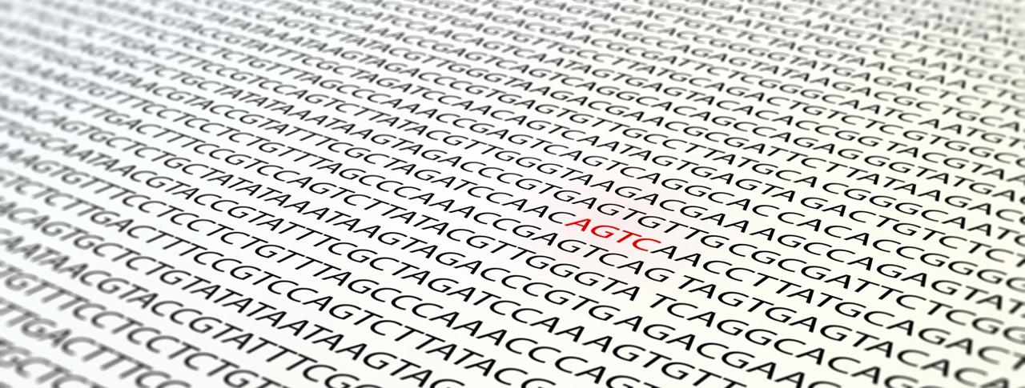
Introduction to NGS
Genome sequencing
Genome sequencing is figuring out the order of DNA nucleotides, or bases, in a genome—the order of As, Cs, Gs, and Ts that make up an organism's DNA.

Slide 9
Introduction to NGS
Genome sequencing
Genome sequencing is figuring out the order of DNA nucleotides, or bases, in a genome—the order of As, Cs, Gs, and Ts that make up an organism's DNA.
3.272.116.950 bp

Slide 10
Introduction to NGS
Why is genome sequencing so important?
How the genome as a whole works: how genes work together to direct the growth, development and maintenance of an entire organism.
Find genes much more easily and quickly.
Genes account for less than 25 percent of the DNA in the genome, and so knowing the entire genome sequence will help scientists study the parts of the genome outside the genes.

Slide 11
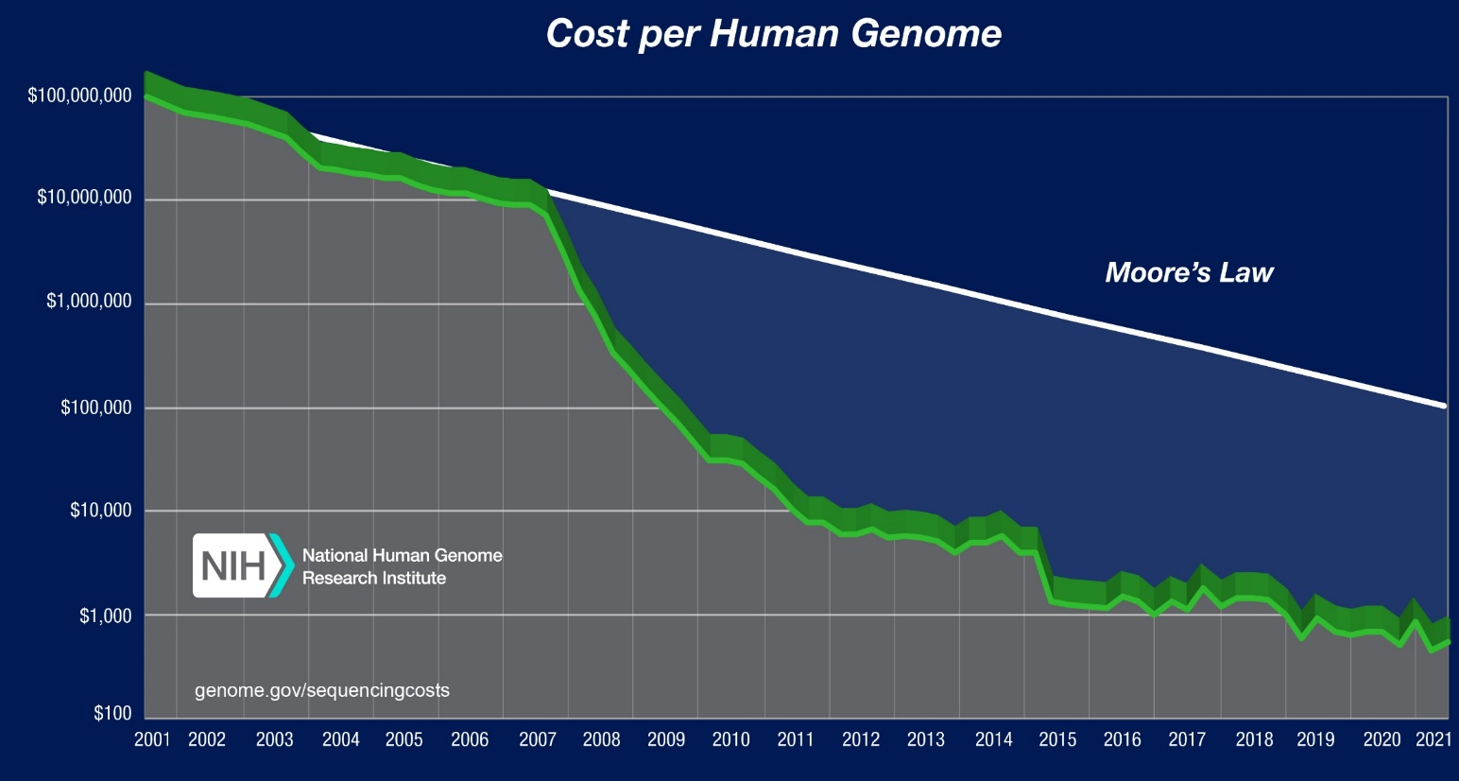
Introduction to NGS
Cost of sequencing
Cost of human genome sequence:
HGP: 1 - 3x10¹²$
2006: 14x10⁶$
2016: 1000-4000$
2019: 200 – 500$
https://www.genome.gov/27565109/the-cost-of-sequencing-a-human-genome/

Slide 12
Introduction to NGS
First Generation Sequencing
Second Generation Sequencing
Third Generation Sequencing
Sequencing generation face to face
Applications of NGS techniques
A (very) brief introduction to DoE

Slide 13
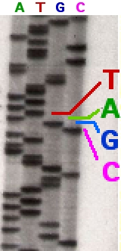
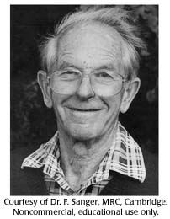
First Generation Sequencing
Sanger sequencing
Method of DNA sequencing based on the selective incorporation of chain terminating dideoxynucleotides by DNA polymerase during in vitro DNA replication. Developed by Frederick Sanger and colleagues in 1977, it was the most widely used sequencing method for approximately 25 years.
Frederick Sanger received two Nobel prizes (in the same category), for his work on protein sequencing and DNA sequencing
http://www.yourgenome.org/stories/third-generation-sequencing

Slide 14
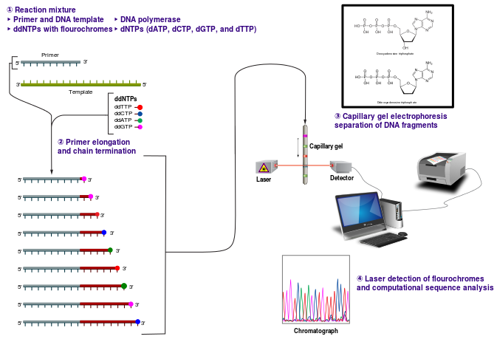
First Generation Sequencing
Sanger sequencing. How it works?
A DNAp enzyme is used to replicate a ssDNA. In the mix reaction, there exist normal and modified nucleotides.
Random incorporation of modified nucleotides stops the synthesis reaction.
Each generated fragment will have a different length that could be distinguish by gel electrophoresis.
https://www.youtube.com/watch?v=vK-HlMaitnE
<1kb read
Notes:
Repasar vídeo de Sanger sequencing

Slide 15
Introduction to NGS
First Generation Sequencing
Second Generation Sequencing
Third Generation Sequencing
Sequencing generation face to face
Applications of NGS techniques
A (very) brief introduction to DoE

Slide 16
Second Generation Sequencing
Why second generation sequencing?
Disadvantage of Sanger sequencing: low sequence output
using of gels or polymers as separation media
limited number of samples which could be handled in parallel
difficulties with automation of the sample preparation
These limitations triggered the efforts to develop new techniques

Slide 17

Second Generation Sequencing
Main characteristics of NGS:
high speed and throughput
shorter reads
accuracy
much higher degree of sequence coverage
Huge data storage demands
Notes:
Sanger (~900 nt)
Short reads (~75-150 nt)
Long reads (~20.000 nt)

Slide 18
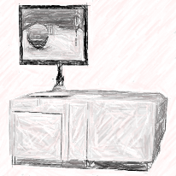
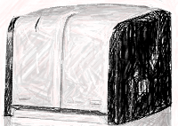
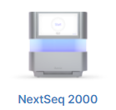
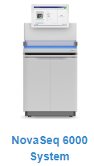
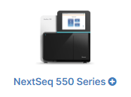
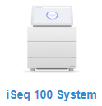
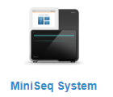
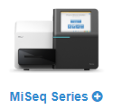
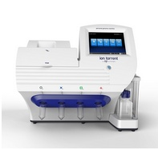

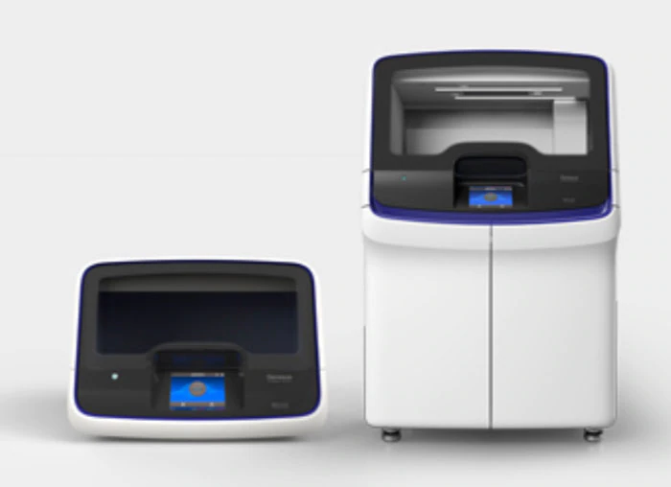
Second Generation Sequencing
Instruments
High throughput Benchtop
x
x
ROCHE
GS FLX+ 454
GS Junior 454
Illumina
Thermofisher
Ion Gene Studio S5 PrimeSystem
Ion Torrent Genexus
IonPGM
Notes:
Estas son las compañías líderes en secuenciación de segunda generación.
La UAT dispone de las plataformas de Roche. → preguntar a Mireia si això és cert ara mateix
Todas ellas han sacado al mercado máquinas que permiten el abordaje de proyectos complejos basados en la secuenciación, pero también, cada compañía dispone de máquinas de menor tamaño, tamaño poyata, idóneoa para laboratorios pequeños, focalizados para el uso de aplicaciones clínicas, muy útiles para la realización de proyectos piloto o proyectos menos complejos, ambiciosos pero aún asÍ con mayor rendimiento y mejor coste que Sanger. Así cabe mencionar el Junior, Miseq y el Ion Torrent.

Slide 19
Second Generation Sequencing
Basic NGS workflow.
1. Library Preparation
It is prepared by random fragmentation of DNA or cDNA sample, followed by adapter ligation. Adapter-ligated fragments are then PCR amplified and gel purified
2. Clonal amplification
Each DNA fragment is amplified millions of times.
3. Sequencing
The nucleotides incorporated are read by the detector

Slide 20
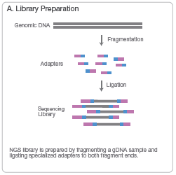
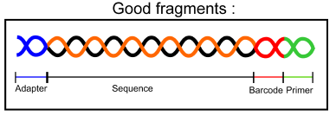
Second Generation Sequencing
Library preparation:
Useful for multiplexing samples
Depending on the final application and method used for sequencing, different kits are available
Notes:
Sample multiplexing, also known as multiplex sequencing, allows large numbers of libraries to be pooled and sequenced simultaneously during a single run on Illumina instruments. Sample multiplexing is useful when targeting specific genomic regions or working with smaller genomes. Pooling samples exponentially increases the number of samples analyzed in a single run, without drastically increasing cost or time.
With multiplex sequencing, individual "barcode" sequences are added to each DNA fragment during next-generation sequencing (NGS) library preparation so that each read can be identified and sorted before the final data analysis. These barcodes, or index adapters, can follow one of two major indexing strategies depending on your library prep kit and application.

Slide 21
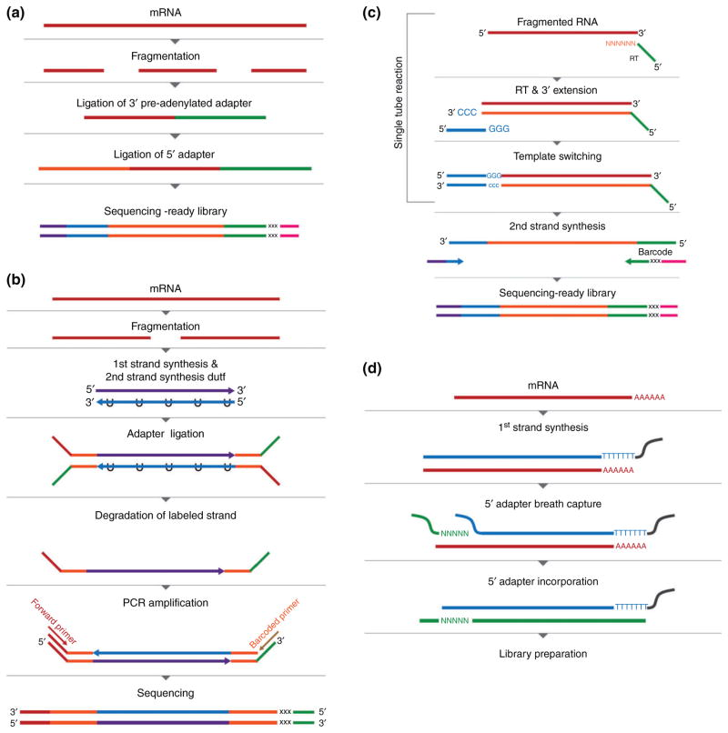
Second Generation Sequencing
Library preparation: Too many methods / kits available
Hrdlickova R, Toloue M, Tian B. RNA-Seq methods for transcriptome analysis. Wiley Interdiscip Rev RNA. 2016;8(1):10.1002/wrna.1364.

Slide 22
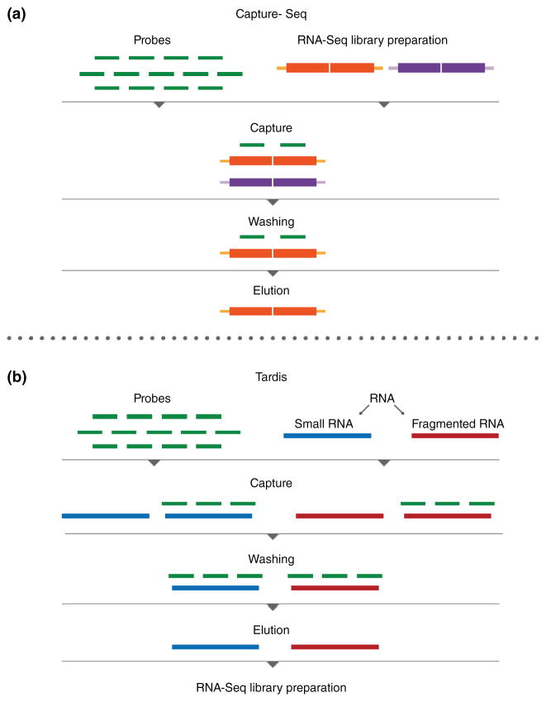
Second Generation Sequencing
Library preparation: Too many methods / kits available
Hrdlickova R, Toloue M, Tian B. RNA-Seq methods for transcriptome analysis. Wiley Interdiscip Rev RNA. 2016;8(1):10.1002/wrna.1364.

Slide 23
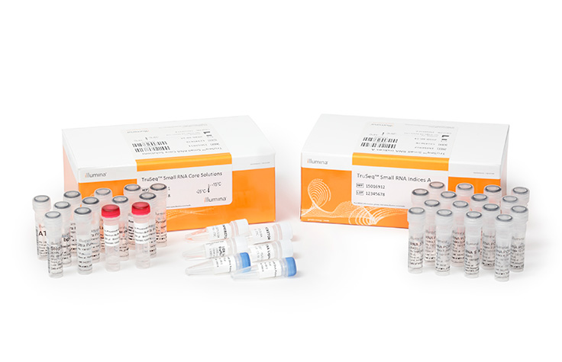
Second Generation Sequencing
Library preparation: Too many methods / kits available
Hrdlickova R, Toloue M, Tian B. RNA-Seq methods for transcriptome analysis. Wiley Interdiscip Rev RNA. 2016;8(1):10.1002/wrna.1364.

Slide 24
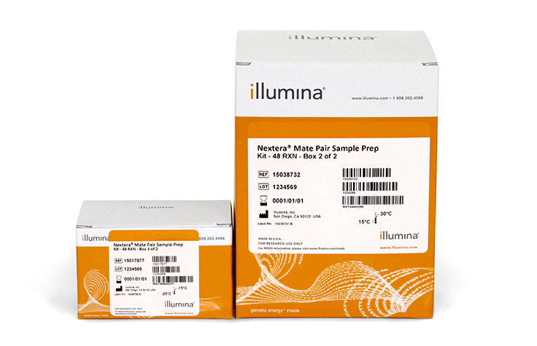
Second Generation Sequencing
Library preparation: Too many methods / kits available
Hrdlickova R, Toloue M, Tian B. RNA-Seq methods for transcriptome analysis. Wiley Interdiscip Rev RNA. 2016;8(1):10.1002/wrna.1364.
Notes:
Hay muchos pipelines de preparación de librerías y distintos kits, aunque todos sigan el mismo principio básico

Slide 25

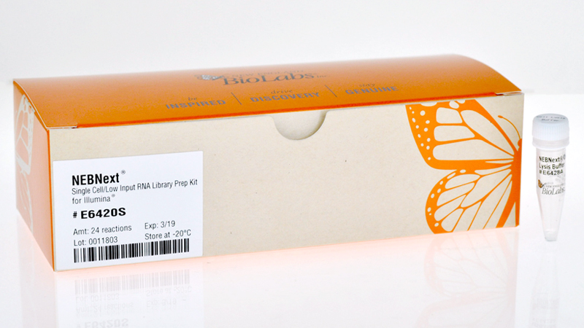
Second Generation Sequencing
Library preparation: Too many methods / kits available
Hrdlickova R, Toloue M, Tian B. RNA-Seq methods for transcriptome analysis. Wiley Interdiscip Rev RNA. 2016;8(1):10.1002/wrna.1364.

Slide 26
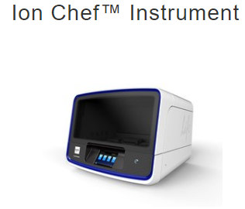
Second Generation Sequencing
Library preparation: Too many methods / kits available
Hrdlickova R, Toloue M, Tian B. RNA-Seq methods for transcriptome analysis. Wiley Interdiscip Rev RNA. 2016;8(1):10.1002/wrna.1364.

Slide 27
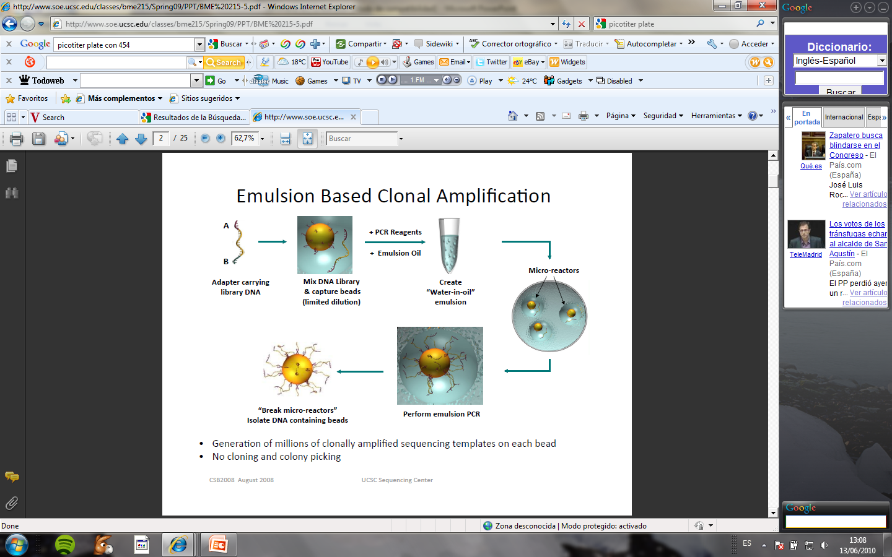
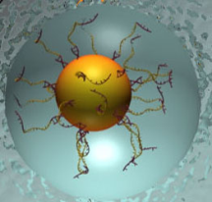
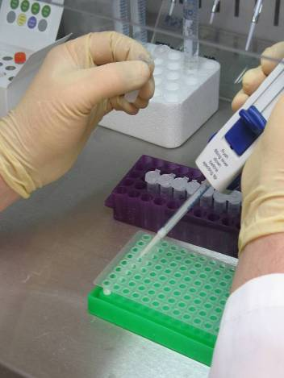
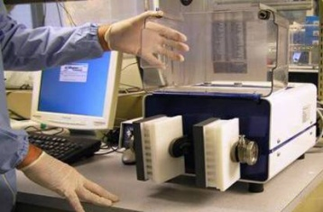
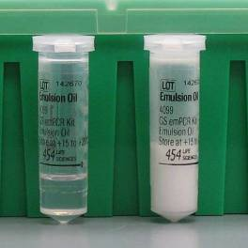
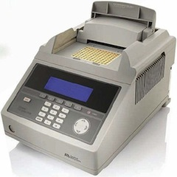
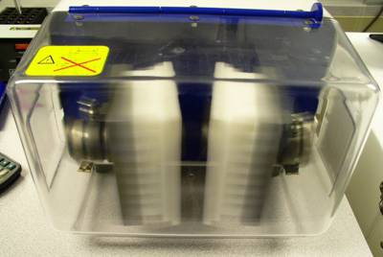
Second Generation Sequencing
Clonal amplification:
For emPCR based systems (Ion/PGM, 454)
High-speed
shaker
-1 starting effective fragment per microreactor
- ~10⁶ microreactors per ml
- All processed in parallel
(Clonal amplification)

Slide 28



Second Generation Sequencing
Clonal amplification:
For emPCR based systems (Ion/PGM, 454)
No empty beads
Clonal amplification??
No beads containing more than one amplified fragment
Titration: constant number of beads vs. different DNA starting quantities
Optimal enrichment: one single fragment amplified millions of times in one single bead

Slide 29
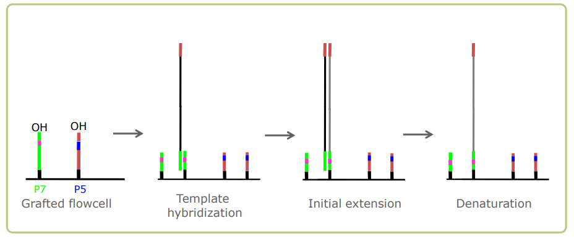
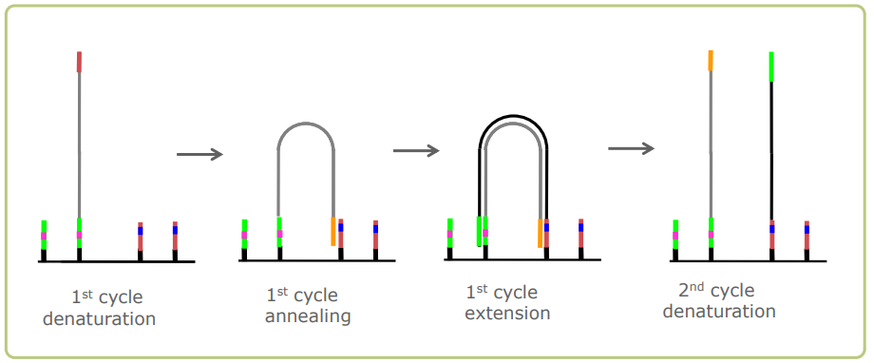

Second Generation Sequencing
Clonal amplification: Illumina

Slide 30
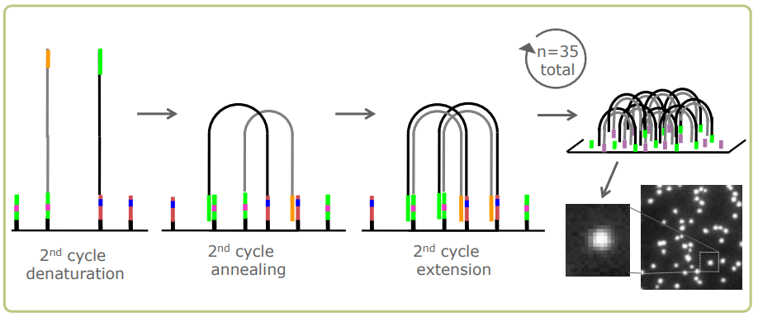
Second Generation Sequencing
Clonal amplification: Illumina

Slide 31
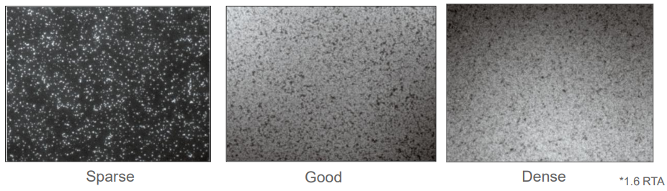
Second Generation Sequencing
Clonal amplification: Bridge PCR (Illumina):
SYBR QC: Ensure successful amplification before continuing
GOAL: Visually confirm successful cluster generation and optimal density before continuing
– Too Sparse: Loss of valuable real estate on flow cell
– Too Dense: Analysis problems
Notes:
fluorescent DNA binding dye

Slide 32
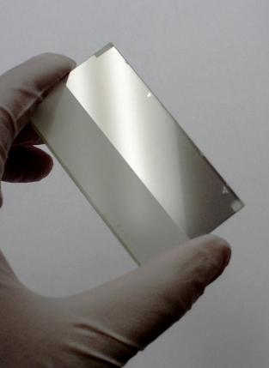
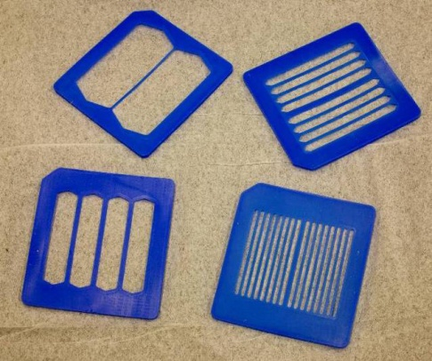
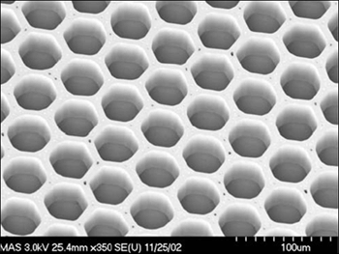
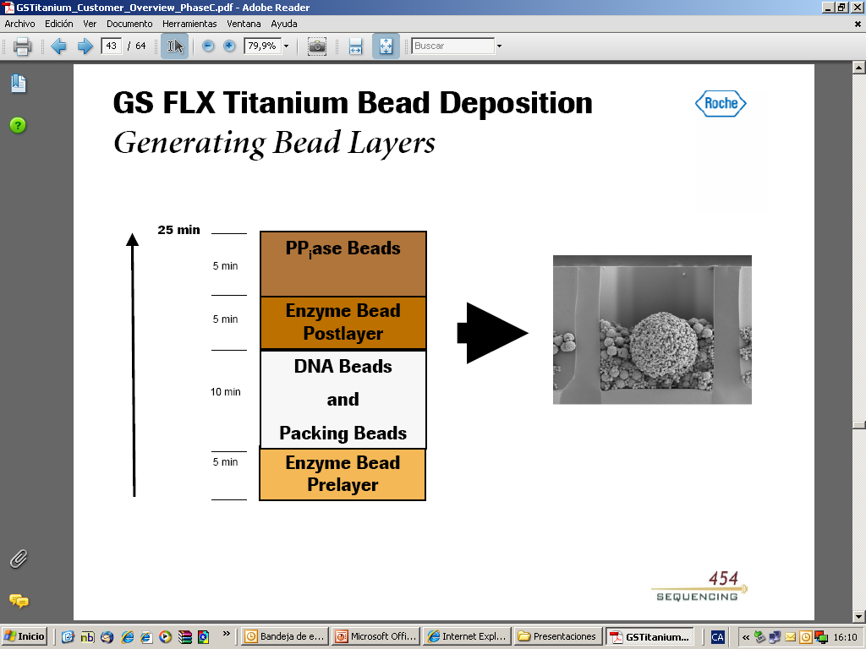
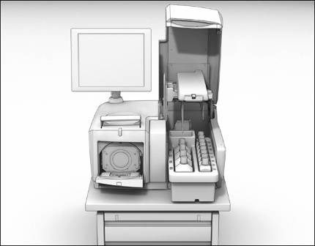
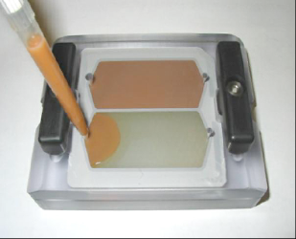
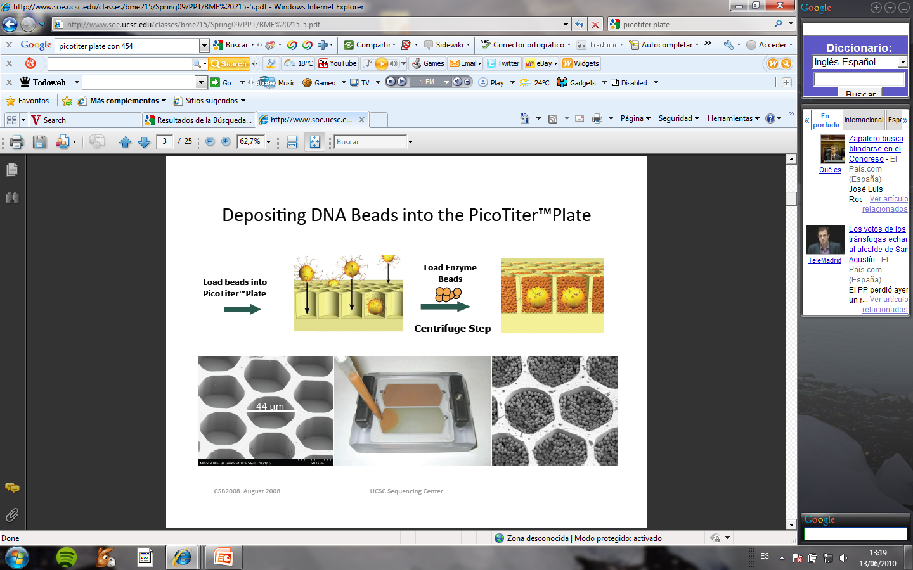
Second Generation Sequencing
Sequencing: Roche 454 (pyrosequencing, sequencing by synthesis)
Metal coated PTP reduces crosstalk
29 μm well diameter (20/bead)
3,400,000 wells per PTP
Notes:
Microrejilla: donde se depositan las microesferas

Slide 33
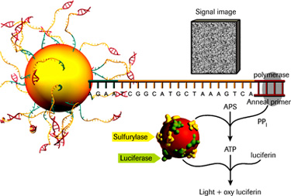



Second Generation Sequencing
Sequencing: Roche 454 (pyrosequencing, sequencing by synthesis)
CCD Camera
signal intensity is proportional to the number of nucleotides incorporated in the sequence
- throughput limited by the nº of wells
errors in homopolymers (454)
long sequences (up to 1000bp)
low throughput, very expensive reagents
required for some specific applications, advisable for others
(de novo sequencing)

Slide 34

Second Generation Sequencing
Sequencing: Illumina (dye terminator nt, sequencing by synthesis)
Limited by the fragment length than can efectively “bridge”
Labelled nucleotides are not incorporated as efficiently as native ones
Short sequences
Scalable set of machines suitable for nearly all the applications
High throughput

Slide 35

Second Generation Sequencing
Illumina workflow.
https://www.youtube.com/watch?annotation_id=annotation_1533942809&feature=iv&src_vid=HMyCqWhwB8E&v=fCd6B5HRaZ8

Slide 36



Second Generation Sequencing
Sequencing: Ion S5/PGM
Beads containing the clonally amplified library are loaded onto the chip.
The chip is run in the machine

Slide 37

Second Generation Sequencing
Sequencing: Ion Torrent

Slide 38

Second Generation Sequencing
Sequencing: Ion Torrent
https://www.youtube.com/watch?v=zBPKj0mMcDg&ab_channel=ThermoFisherScientific

Slide 39




Second Generation Sequencing
Small NGS platforms
2.016
MiniSeq (Illumina)
Read Length: 2x150 bp
Output: 0.6 - 7.5 Gb
Running time: 4 - 24 hours
GS Junior Plus (Roche)
Read Length: 700 pb
Output: 70 Mb
Running time: 18 hours
Ion Torrent PGM (LifeTechnol.)
Read length: 200 to 400 bp
Output: 30Mb – 2Gb
Running time: 2,3 - 4,4 hours
Applications:
Amplicon sequencing
Targeted sequencing (DNA / RNA)
Metagenomics (16S)
Source: Supplier webpage

Slide 40

Second Generation Sequencing
High throughput NGS Platforms
NGS platforms
2.016
GS FLX+
Ion Gene Studio S5 Prime System
Read length: 700 bp
Output: 1 Mb
Running time: 23 hours
Read length: Up to 200 bp
Output: 50Gb/day (2 chips)
Run time: 8,5 hours
Read length: 2x150 bp
Output: 6.000 Gb
Run time: 44 hours
Applications:
Amplicon sequencing
Targeted sequencing
Metagenomics (16S)
Genomes
Exomes, transcriptome
Source: Supplier webpage

Slide 41

Second Generation Sequencing
High throughput NGS Platforms
Source: Supplier webpage

Slide 42

Second Generation Sequencing
High throughput NGS Platforms
Source: Supplier webpage

Slide 43




Second Generation Sequencing
High throughput NGS Platforms
Source: Supplier webpage

Slide 44
Introduction to NGS
First Generation Sequencing
Second Generation Sequencing
Third Generation Sequencing
Sequencing generation face to face
Applications of NGS techniques
A (very) brief introduction to DoE

Slide 45
Third Generation Sequencing
Single molecule sequencing
Advantages:
Less sample preparation (no PCR)
No amplification
No PCR errors
Fewer contamination issues
No GC-bias
Analyze every sample (unPCRable, unclonable)
Analyze low quality DNA (forensics samples, archeological)
Absolute quantification
Sequence RNA directly

Slide 46


Third Generation Sequencing
Helicos Genetic Analysis system
Workflow similar to Illumina, but
without amplification:
relative slow and expensive
short reads
single molecule sequencing

Slide 47
Third Generation Sequencing
Helicos Genetic Analysis system
Workflow similar to Illumina, but
without amplification:
relative slow and expensive
short reads
single molecule sequencing

Slide 48

Third Generation Sequencing
Sequel System (Pacific bioscience)
Quick library construction (< 3 hours)
Run time: from 30 min to 30 hours
Sequencing by synthesis
No library amplification
Long reads: 5 Kb – 20 Kb
Source: Supplier webpage

Slide 49
Third Generation Sequencing
Sequel System (Pacific bioscience)
Quick library construction (< 3 hours)
Run time: from 30 min to 30 hours
Sequencing by synthesis
No library amplification
Long reads: 5 Kb – 20 Kb
Source: Supplier webpage

Slide 50



Third Generation Sequencing
Sequel System (Pacific bioscience)
https://www.youtube.com/watch?v=_lD8JyAbwEo&feature=emb_rel_end&ab_channel=PacBio

Slide 51


Third Generation Sequencing
Oxford nanopore
alpha-hemolysin
Heptameric protein with a pore of inner diameter 1nm
Pore diameter same scale of DNA
Protein nanopores can be adapted.
The company has optimised its large-scale production.
DNA, RNA, miRNA and protein analysis
Changes in membrane voltage are measured

Slide 52



Third Generation Sequencing
Oxford nanopore
MinION GridION PromethION
Simple 10 minute sample prep available
Read length: Ultra long reads (2 Mb)
Very fast, but high error rates.
Easy to work in the field (Ebola viruses sequenced in Guinea 2 days after sample collection, Quick J, 2016)

Slide 53

Third Generation Sequencing
Oxford nanopore
https://www.youtube.com/watch?v=GUb1TZvMWsw

Slide 54




Third Generation Sequencing
3rd generation instruments
High througput
Benchtop
Pacific
Bioscience
Sequel system
Oxford Nanopore
Technologies
PromethION GridION minION
Notes:
Estas son las compañías líderes en secuenciación de segunda generación.
La UAT dispone de las plataformas de Roche.
Todas ellas han sacado al mercado máquinas que permiten el abordaje de proyectos complejos basados en la secuenciación, pero también, cada compañía dispone de máquinas de menor tamaño, tamaño poyata, idóneoa para laboratorios pequeños, focalizados para el uso de aplicaciones clínicas, muy útiles para la realización de proyectos piloto o proyectos menos complejos, ambiciosos pero aún asÍ con mayor rendimiento y mejor coste que Sanger. Así cabe mencionar el Junior, Miseq y el Ion Torrent.

Slide 55
Introduction to NGS
First Generation Sequencing
Second Generation Sequencing
Third Generation Sequencing
Sequencing generation face to face
Applications of NGS techniques
A (very) brief introduction to DoE

Slide 56

Sequencing Generation face to face
Speed variation by technology
http://www.yourgenome.org/stories/third-generation-sequencing

Slide 57

Sequencing Generation face to face

Slide 58
Sequencing Generation face to face

Slide 59
Sequencing Generation face to face

Slide 60
Sequencing Generation face to face

Slide 61
Sequencing Generation face to face

Slide 62










Sequencing Generation face to face
1. DNA fragmentation.
1. DNA fragmentation
1. DNA fragmentation
2. Vector cloning, bacterial transformation and growth, DNA isolation and purification
2. In vitro adaptor ligation + clonal amplification
2. y 3. in vitro adaptor ligation. NO AMPLIFICATION.
Massive parallel sequencing.
3. Sequencing (chain-terminating ddnucleotides)
3. Massive paralel sequencing
ssDNA
DNA primer
Polimerase
dNTPs
Fluorescent ddNTPs
4. Image processing
4. Image processing and data analysis
4. Image processing and data analysis.
Capillary electrophoresis
(1 Sequence/Capilar. Up to 384 DNA samples in a single run)
CTATGCTCG
FGS
SGS
TGS

Slide 63

Sequencing Generation face to face
Release dates vs Machine outputs per run
https://genohub.com/ngs-instrument-guide/

Slide 64
Introduction to NGS
First Generation Sequencing
Second Generation Sequencing
Third Generation Sequencing
Sequencing generation face to face
Applications of NGS techniques
A (very) brief introduction to DoE

Slide 65

Applications of NGS techniques

Slide 66

Applications of NGS techniques

Slide 67



Applications of NGS techniques
Depth of Coverage: average number of reads that align to, or "cover," known reference bases.
30x = each base has been covered by 30 sequences (in average)
https://genohub.com/recommended-sequencing-coverage-by-application/

Slide 68
Applications of NGS techniques
https://genohub.com/recommended-sequencing-coverage-by-application/

Slide 69
Applications of NGS techniques
Category | Detection or Application | Recommended Coverage (x) or Reads (millions) | References
Whole genome sequencing | Homozygous SNVs | 15x | Bentley et al., 2008
 | Heterozygous SNVs | 33x | Bentley et al., 2008
 | INDELs | 60x | Feng et al., 2014
 | Genotype calls | 35x | Ajay et al., 2011
 | CNV | 1-8x | Xie et al., 2009; Medvedev at al., 2010
Whole exome sequencing | Homozygous SNVs | 100x (3x local depth) | Clark et al., 2011; Meynert et al., 2013
 | Heterozygous SNVs | 100x (13x local depth) | Clark et al., 2011; Meynert et al., 2013
 | INDELs | not recommended | Feng et al., 2014
Transcriptome Sequencing | Differential expression profiling | 10-25M | Liu Y. et al., 2014; ENCODE 2011 RNA-Seq
 | Alternative splicing | 50-100M | Liu Y. et al., 2013; ENCODE 2011 RNA-Seq
 | Allele specific expression | 50-100M | Liu Y. et al., 2013; ENCODE 2011 RNA-Seq
 | De novo assembly | >100M | Liu Y. et al., 2013; ENCODE 2011 RNA-Seq
DNA Target-Based Sequencing | ChIP-Seq | 10-14M (sharp peaks); 20-40M (broad marks) | Rozowsky et al., 2009; ENCODE 2011 Genome; Landt et al., 2012
 | Hi-C | 100M | Belton, J.M et al., 2012
 | 4C (Circularized Chromosome Confirmation Capture) | 1-5M | van de Weken, H.J.G. et al., 2012
 | 5C (Chromosome Carbon Capture Carbon Copy) | 15-25M | Sanyal A. et al., 2012
 | ChIA-PET (Chromatin Interaction Analysis by Paired-End Tag Sequencing) | 15-20M | Zhang, J. et al., 2012
 | FAIRE-Seq | 25-55M | ENCODE 2011 Genome; Landt et al., 2012
 | DNAse 1-Seq | 25-55M | Landt et al., 2012
DNA Methylation Sequencing | CAP-Seq | >20M | Long, H.K. et al., 2013
 | MeDIP-Seq | 60M | Taiwo, O. et al., 2012
 | RRBS (Reduced Representation Bisulfite Sequencing) | 10X | ENCODE 2011 Genome
 | Bisulfite-Seq | 5-15X; 30X | Ziller, M.J et al., 2015; Epigenomics Road Map
RNA-Target-Based Sequencing | CLIP-Seq | 10-40M | Cho J. et al., 2012; Eom T. et al., 2013; Sugimoto Y. et al., 2012
 | iCLIP | 5-15M | Sugimoto Y. et al., 2012; Rogelj B. et al., 2012
 | PAR-CLIP | 5-15M | Rogelj B. et al., 2012
 | RIP-Seq | 5-20M | Lu Z. et al., 2014
Small RNA (microRNA) Sequencing | Differential Expression | ~1-2M | Metpally RPR et al., 2013; Campbell et al., 2015
 | Discovery | ~5-8M | Metpally RPR et al., 2013; Campbell et al., 2015
https://genohub.com/recommended-sequencing-coverage-by-application/

Slide 70








Applications of NGS techniques
Whole Genome sequencing
De novo sequencing
Resequencing

Slide 71
Applications of NGS techniques
Whole Genome sequencing
Complete characterization of the entire genome.
The rapid drop in sequencing costs allow researchers to sequence a genome quickly.

Slide 72
Applications of NGS techniques
Whole Genome sequencing
PROS
Global genome picture, no systematic missing of information
Useful for diseases that involve multiple genetic phenomena
CONS:
Can miss variants in the exonics regions due to lower coverage
Some regions cannot be sequenced/assembled (repetitive and GC rich regions)
More expensive and time consuming

Slide 73

Applications of NGS techniques
Targeted sequencing
Only a subset of genes or regions of the genome are isolated and sequenced.
It allows to focus times, expenses and data analysis on specific areas of interest.
Enables sequencing at much higher coverage levels.
Target sequencing panels can be purchased with preselected content or can be custom designed.

Slide 74

Applications of NGS techniques
Exome sequencing
Identifies variants across a wide range of applications
Achieves comprehensive coverage of coding regions
Provides a cost-effective alternative to whole-genome sequencing (4–5 Gb of sequencing per exome compared to ~90 Gb per whole human genome)
Produces a smaller, more manageable data set for faster, easier analysis compared to whole-genome approaches

Slide 75
Applications of NGS techniques
RNA-seq Expression Analysis
Sequencing every RNA molecule and profiling the expression of a particular gene by counting the number of time its transcripts have been sequenced.
Sensitivity of sequence based studies is limited by the depth of sequencing
Applications:
Differential gene expression analysis (DGE)
Splice variants (resolution at base-level)
Detection of novel transcripts and isoforms
Detection of allele specific expression patterns

Slide 76
Applications of NGS techniques
RNA-seq Expression Analysis
Sequencing every RNA molecule and profiling the expression of a particular gene by counting the number of time its transcripts have been sequenced.
Sensitivity of sequence based studies is limited by the depth of sequencing
Applications:
Differential gene expression analysis (DGE)
Splice variants (resolution at base-level)
Detection of novel transcripts and isoforms
Detection of allele specific expression patterns
TGS

Slide 77

Applications of NGS techniques
Very high dynamic range (10⁵ to 10⁷)

Slide 78
Applications of NGS techniques
ChIP-seq
analyze protein interactions with DNA: Transcription factors
ChIP-seq combines chromatin immunoprecipitation (ChIP) with massively parallel DNA sequencing to identify the binding sites of DNA-associated proteins
used to map global binding sites precisely for any protein of interest

Slide 79
Applications of NGS techniques
Single cell RNA-seq (scRNA-seq)
Allows comparison of the transcriptomes of individual cells
sequence the transcriptomes of up to tens of thousands of individual cells for a single project
Results depend of protocol used
Special attention to single cell purification
Low signal of weak expressed genes
Required number of cells increases with the complexity of the sample under investigation
Requires specific bioinformatic approaches.

Slide 80


Applications of NGS techniques
Single cell RNA-seq (scRNA-seq)
Different methods for isolating single cells from a cell suspension:
Fluorescence-activated cell sorting (FACS)
Microfluidics: allows separation and cDNA synthesis and transcriptome amplification
Mechanical micromanipulation/micropipetting
Laser capture microdissection

Slide 81


Applications of NGS techniques
Single cell RNA-seq (scRNA-seq)
Also different methods for cDNA transcription….

Slide 82

Applications of NGS techniques
Single cell RNA-seq (scRNA-seq)
Also different methods for reads mapping….

Slide 83

Applications of NGS techniques
Single cell RNA-seq (scRNA-seq)
Also different methods for reads mapping….
For differential expression analysis…..

Slide 84


Applications of NGS techniques
Single cell RNA-seq (scRNA-seq)
To create comprehensive reference maps of all human cells
https://www.humancellatlas.org/

Slide 85


Applications of NGS techniques
Metagenomics
Is a way to make an inventory of what (DNA) is present in a sample
Two approaches:
Sequence it all
Focus on specific conserved sequences (ribosomal genes)
Technology facilitates the study of the consequences of environmental changes and the causes of the changes.

Slide 86
Introduction to NGS
First Generation Sequencing
Second Generation Sequencing
Third Generation Sequencing
Sequencing generation face to face
Applications of NGS techniques
A (very) brief introduction to DoE

Slide 87

A (very) brief introduction to DoE
The (statistical) design of experiments is an efficient procedure for planning experiments so that the data obtained can be analyzed to yield valid and objective conclusions
Why are many life scientists so adverse to thinking about design?
It is common to think that time spent designing experiments would be better spent actually doing experiments

Slide 88


A (very) brief introduction to DoE
Variability types that play in an experiment:
Planned systematic variability: This is the differences in response between treatments applied.
Noise variability: random noise. Differences between two consecutives measures. We cannot avoid that.
Systematic variability not planned: Produce a systematic variation in the results. A priori the reason is not known. It can be avoided with the randomization and the local control.

Slide 89

A (very) brief introduction to DoE
Important steps to define before begin the experiment:
Establish the main objectives of the experiment. Avoid collateral problems
Identify all the noise sources: Treatment, experimental errors,…
Allocate each experimental unit which each treatment
Clarify the type of response expected in each treatment
Determinate the number of individuals in each group
Run a pilot study

Slide 90
A (very) brief introduction to DoE
Important steps to define before begin the experiment:
Establish the main objectives of the experiment. Avoid collateral problems
Identify all the noise sources: Treatment, experimental errors,…
Allocate each experimental unit which each treatment
Clarify the type of response expected in each treatment
Determinate the number of individuals in each group
Run a pilot study

Slide 91
A (very) brief introduction to DoE
Important steps to define before begin the experiment:
Establish the main objectives of the experiment. Avoid collateral problems
Identify all the noise sources: Treatment, experimental errors,…
Allocate each experimental unit which each treatment
Clarify the type of response expected in each treatment
Determinate the number of individuals in each group
Run a pilot study

Slide 92
A (very) brief introduction to DoE
Important steps to define before begin the experiment:
Establish the main objectives of the experiment. Avoid collateral problems
Identify all the noise sources: Treatment, experimental errors,…
Allocate each experimental unit which each treatment
Clarify the type of response expected in each treatment
Determinate the number of individuals in each group
Run a pilot study
How the data will be statistically analysed.

Slide 93
A (very) brief introduction to DoE
Sample | Treatment | Sex | Batch |  | Sample | Treatment | Sex | Batch
1 | A | Male | 1 |  | 1 | A | Male | 1
2 | A | Male | 1 |  | 2 | A | Female | 2
3 | A | Male | 1 |  | 3 | A | Male | 2
4 | A | Male | 1 |  | 4 | A | Female | 1
5 | B | Female | 2 |  | 5 | B | Male | 1
6 | B | Female | 2 |  | 6 | B | Female | 2
7 | B | Female | 2 |  | 7 | B | Male | 2
8 | B | Female | 2 |  | 8 | B | Female | 1
Treatment are confounded between sex and batch

Slide 94
A (very) brief introduction to DoE
Sample | Treatment | Sex | Batch |  | Sample | Treatment | Sex | Batch
1 | A | Male | 1 |  | 1 | A | Male | 1
2 | A | Male | 1 |  | 2 | A | Female | 2
3 | A | Male | 1 |  | 3 | A | Male | 2
4 | A | Male | 1 |  | 4 | A | Female | 1
5 | B | Female | 2 |  | 5 | B | Male | 1
6 | B | Female | 2 |  | 6 | B | Female | 2
7 | B | Female | 2 |  | 7 | B | Male | 2
8 | B | Female | 2 |  | 8 | B | Female | 1
Treatment are confounded between sex and batch
Treatment is well balanced

Slide 95
A (very) brief introduction to DoE
LOCAL CONTROL
REPLICATION
RANDOMIZATION
Notes:
EC: Replication, with randomization, will provide a basis for estimating the error variance. ... Local control, like replication is yet another device to reduce or control the variation due to extraneous factors and increase the precision of the experiment.
Almost all experiments involve the three basic principles, viz., randomization, replication and local control. These three principles are, in a way, complementary to each other in trying to increase the accuracy of the experiment and to provide a valid test of significance, retaining at the same time the distinctive features of their roles in any experiment. Before we actually go into the details of these three principles, it would be useful to understand certain generic terms in the theory experimental designs and also understand the nature of variation among observations in an experiment.

Slide 96
A (very) brief introduction to DoE
What do you need to ask before starting a NGS experiment?

Slide 97
A (very) brief introduction to DoE
What do you need to ask before starting a NGS experiment?
What do I want to sequence? Whole genome, exome, metagenome, epigenome, RNAseq.....
How many samples?
Length of read required?
Quality and quantity of starting material?
Size of nucleic acids to sequence
Amount of sequence needed: coverage

